Slide 1
Visual Analytics for Tabular Data with weak hierarchies
Thesis: Jalaj Vora Supervised by: Benedikt Mayer

Slide 2
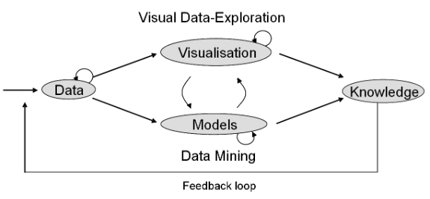
Visual Analytics Pipeline

